Slide 1






seismic hazard assessment system
Student Details
Name: SAMUTHRA DEVI S
NM Id:aut2211l313
College Name: GCE SALEM

Slide 2
Disclaimer
The content is curated from online/offline resources and used for educational purpose only

Slide 3

Course Outline
Abstract
Problem Statement
Aims, Objective & Proposed System/Solution
System Deployment Approach
Model Development & Algorithm
Future Scope
Video of the Project
Conclusion
Reference

Slide 4
Abstract
Seismic hazard assessment systems play a critical role in understanding and mitigating the risks associated with earthquakes, a natural phenomenon that poses significant threats to infrastructure, communities, and lives. This abstract presents a comprehensive framework for a seismic hazard assessment system designed to integrate advanced geospatial technologies, geological data, and computational modeling techniques. The proposed system incorporates multiple layers of analysis, including seismicity analysis, fault characterization, ground motion prediction, and vulnerability assessment, to provide a holistic understanding of seismic.

Slide 5
Problem Statement
Scope Definition: Clearly defining the geographic area or region for which the seismic hazard assessment is being conducted.
Risk Identification: Identifying and characterizing potential seismic hazards within the specified area, including faults, seismic activity history, and geological features that may contribute to earthquake risk.
Data Collection and Analysis: Gathering relevant data such as historical earthquake records, geological surveys, geophysical data, and information on infrastructure and population density. Analyzing this data to assess the likelihood and potential severity of future earthquakes.

Slide 6
4.Modeling and Simulation: Developing mathematical models and simulations to predict the behavior of seismic events within the region, considering factors such as magnitude, frequency, and ground shaking intensity.
5.Vulnerability Assessment: Evaluating the vulnerability of buildings, infrastructure, and populations to seismic events, taking into account construction standards, building codes, and socioeconomic factors.
and changes in the built environment or population dynamics.

Slide 7
Aim and Objective
The objectives of a seismic hazard assessment system typically include:
Risk Mitigation: Identifying areas prone to seismic activity helps in implementing appropriate building codes, land-use planning, and infrastructure design to minimize damage and casualties in the event of an earthquake.
Public Safety: Providing accurate information about seismic hazards helps authorities and the public to understand the risks and take necessary precautions to enhance safety and emergency preparedness.
Engineering Design: Engineers and architects use seismic hazard assessments to design structures that can withstand the expected level of ground shaking, ensuring the safety of occupants and preserving critical infrastructure.

Slide 8
4.Insurance and Finance: Insurance companies and financial institutions utilize seismic hazard assessments to determine premiums, assess risks, and make informed decisions regarding investments in high-risk areas.
5.Scientific Research: Continual monitoring and analysis of seismic hazards contribute to the advancement of scientific understanding of earthquake processes and their impacts on society and the environment.

Slide 9
Objectives
Research and Risk Identification
Risk Quantification
Zoning and Mapping
Structural Design Guidelines
Emergency Preparedness and Response
Public Awareness and Education
Continuous Monitoring

Slide 10

Proposed Solution
Seismic Hazard Modeling
Geospatial Analysis and Mapping
Structural Vulnerability Assessment
Risk Assessment and Management
Early Warning Systems
Public Education and Outreach
Policy Development and Implementation
Data Collection and Compilation:
Continual Improvement and Innovation
Notes:
10

Slide 11
System Deployment Approach
Data Collection and Processing
Model DevelopmentSoftware Development
Continuous Improvement and Maintenance
Requirement Analysis
Documentation and Training
Collaboration and Stakeholder Engagement
Adherence to Standards and Best Practices
Notes:
11

Slide 12
Model Development & Algorithm
import numpy as np
# Define a function to perform Probabilistic Seismic Hazard Analysis (PSHA)
def psha(magnitude, distance):
# Example ground motion prediction equation (GMPE) parameters
a = 0.1
b = 0.5
# Compute the seismic hazard using a simplified GMPE
hazard = np.exp(a * magnitude - b * distance)
return hazard
# Define earthquake parameters
magnitude = 7.0 # Magnitude of the earthquake
distance = 50.0 # Distance from the earthquake epicenter (in km)
# Perform PSHA to estimate the seismic hazard
seismic_hazard = psha(magnitude, distance)
# Print the result
print("Seismic hazard:", seismic_hazard)
Notes:
12

Slide 13
Result
The result of a seismic hazard assessment system typically provides information about the potential for earthquake activity in a specific region.
This assessment considers various factors such as historical seismic activity, geological characteristics of the area, fault lines, and other relevant data to estimate the likelihood and potential impact of earthquakes of different magnitudes.
Notes:
13

Slide 14

Future Scope
Improved Data Integration
Machine Learning and AI
High-Resolution Mapping
Incorporating Uncertainty Analysis
Real-Time Monitoring and Early Warning Systems
Community Engagement and Education
Integration with Urban Planning and Infrastructure Development
Global Collaboration and Data Sharing
Notes:
14

Slide 15
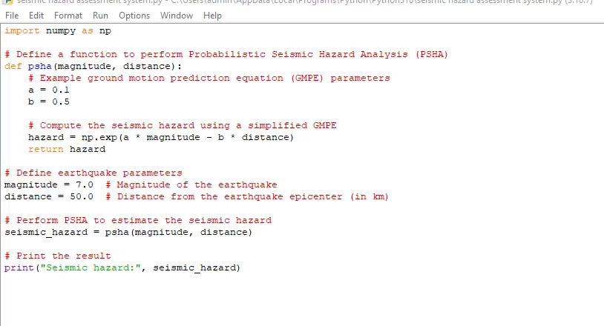
Video of the Project
Notes:
15

Slide 16
Conclusion
In conclusion, seismic hazard assessment systems play a pivotal role in understanding, quantifying, and mitigating the risks associated with earthquakes.
These systems integrate diverse datasets, advanced modeling techniques, and stakeholder engagement to provide valuable insights into seismic hazards and inform decision-making processes. Through probabilistic and deterministic seismic hazard analysis, these systems estimate the likelihood and potential consequences of earthquakes, enabling stakeholders to prioritize risk reduction measures, strengthen building codes, and enhance emergency preparedness.
Notes:
16

Slide 17
Reference
1. Stein, S., & Wysession, M. (Eds.). (2003). "An Introduction to Seismology, Earthquakes, and Earth Structure." Blackwell Publishing. 2. McGuire, R. K. (Ed.). (2004). "Earthquake Hazards and Risk in the United States." US Geological Survey. 3. Wyss, M., & Wiemer, S. (Eds.). (2005). "Induced Seismicity." Springer Science & Business Media
Notes:
Reference
These are the references for this session.

Slide 18
Thank you!
Notes:
18

